Slide 1



Privacy Consent on FHIR (PCF) https://profiles.ihe.net/ITI/PCF
John Moehrke (By-Light)
IHE IT-Infrastructure co-chair
HL7 Security WG co-chair

Slide 2
Agenda
Foundation of Privacy Policies and Choices → Appendix P
Capturing Consent – the output of the Consent Ceremony
Consent Patterns supported: Basic, Intermediate, Advanced
Authorization Decisions based on Consents
Enforcing Authorization Decisions

Slide 3
Use-Cases – Not exhaustive list
Consent for use within an Organization
Centralized Consent authorizing disclosure
Consent authorizing data request
Basic Consent – Implied Consent vs Explicit Consent
Intermediate Consent
By data date, data Id, data author, episode/encounter, PurposeOfUse
Advanced Consent
Data Segmentation for Privacy (DS4P)– Data Tagging to sensitivity categories
Notes:
Within an Organization Consent doesn’t tend to need to be managed in an Interoperable form
Privacy Preferences – are patient authored preferences, thus are not enforceable. Consent should be based upon preferences.

Slide 4
IHE – Integrating the Healthcare Enterprise
Interoperability Standards Organization that profiles the best standard for a given use-case
IHE Profiles are Implementation Guides
Volume 1 – Defines the use-cases and how Actors use
Transactions / Content
Volume 2 – Defines detailed Interop constraints on Transaction
Volume 3 – Defines detailed Interop on reusable Content modules
Volume 4 – National Extensions
https://profiles.ihe.net
Notes:
Best known for XDS, XCA, and Radiology Scheduled Workflow
Many joint projects between HL7 and IHE: Health Story → C-CDA

Slide 5
Appendix P: Privacy Policies
Informative and Foundational

Slide 6
Privacy Policies
Policies – details of how data will be handled
When No Consent is on file
When Consent is on file
When conflicting consents are on file
RBAC vs ABAC – The normal business rules are foundation of Privacy Consent
Break-Glass – Who is authorized, and what will happen if used?
Audit Logging
Policies around reviewing by Privacy office
Access by Patient to all uses of their data
Notes:
Consent is fundamentally based on some organizational declared policies -

Slide 7
Security Labeling Service – Stigmatizing
E.g. Alcohol abuse, Drug abuse, Mental Health, Sexual assault, HIV
Single clinical codes match (LOINC, SNOMED, etc) are not enough
ValueSets exist
All ValueSets would need review and adjustment regularly
Complexity of combinatorics – set of 3 drugs is a strong indicator of HIV. Set of 2 drugs is a strong indicator of abortion.
“Normal” confidentiality → statistically most of health data
“Restricted” confidentiality → more sensitive so should be more restricted
Architectures: During Publication vs During Use
Notes:
Privacy Sensitive – stigmatizing, but also embarrassing, discrimination, or other that results in harm due to the data being exposed.
During Publication is least overhead, but least accurate and least able to deal with changing policies over time
During Use may interfere with performance, but impact may be able to be kept low
Hybrid – pre assess the data when that patient is registered; only pre assess data that has no current assessment

Slide 8
Volume 1: Use-Case analysis

Slide 9
Use-Case
Part 1: Profiling of Consent
Capturing the facts of a Privacy Consent Ceremony
Supporting maintaining Privacy Consent
Supporting changing Privacy Consent
Part 2: Access Control
Enforcing the Privacy Consent during activities
Integrated into typical oAuth flow, that protects business rules (RBAC)
Adds protection of Privacy according to Privacy Consents on file

Slide 10
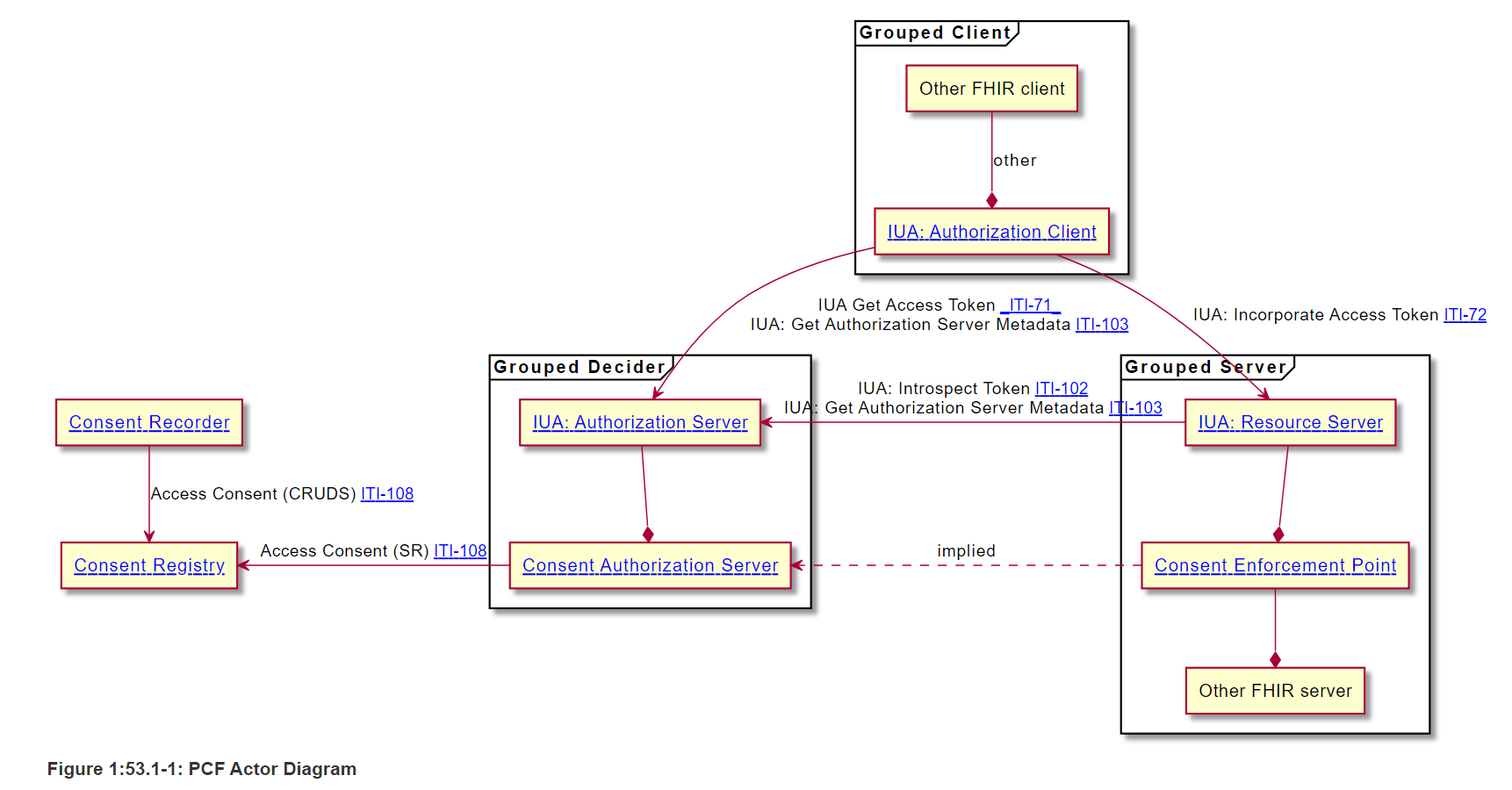
Actors / Transactions
Notes:
Left – Capturing and Maintaining the Privacy Consent
Out of scope, but critical, is the Consent Ceremony. The Consent Ceremony is based on the Policies, alternatives the policies allow, interaction with Privacy Preferences, and is highly reliant on the interaction with the Patient or their authorized delegate.
Right Side is how the Consent influences any application or user interacting with that Patient’s data

Slide 11
Volume 2: Transaction
Capturing and Maintaining the Patient’s Privacy Consent

Slide 12
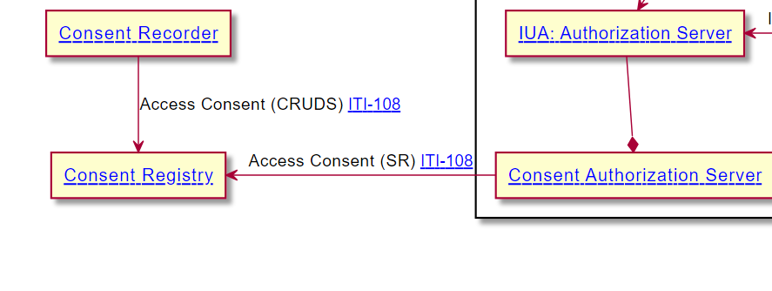
Capturing Privacy Consent
Consent Registry is a simple FHIR server, it has no logic
Consent Authorization Server accesses (Searches and Reads)
Consent Recorder is responsible for the Consent Ceremony, Consistency of Consents on file, Maintenance, workflow, etc.
Complexity of Consent no more complex than Access Control can handle
Transaction is FHIR http RESTful – Create/Read/Update/Delete/Search

Slide 13
Volume 3: Consent profiles

Slide 14
Privacy Consent Profiles
Implied Consent
Basic-normal (TPO), all-normal, only-break-glass, deny-all
Explicit Basic Consent
Identified base policy, timeframe of the consent, who is authorized, who gave consent, what purposeOfUse
Explicit Intermediate
Data Timeframe, Data Id, Data Author, Data Relationship, and PurposeOfUse
Explicit Advanced
Reliant on a Security Labeling Service
And any combinations
Notes:
Volume 3 has profiles on Consent, and Examples of each

Slide 15
Access Control

Slide 16
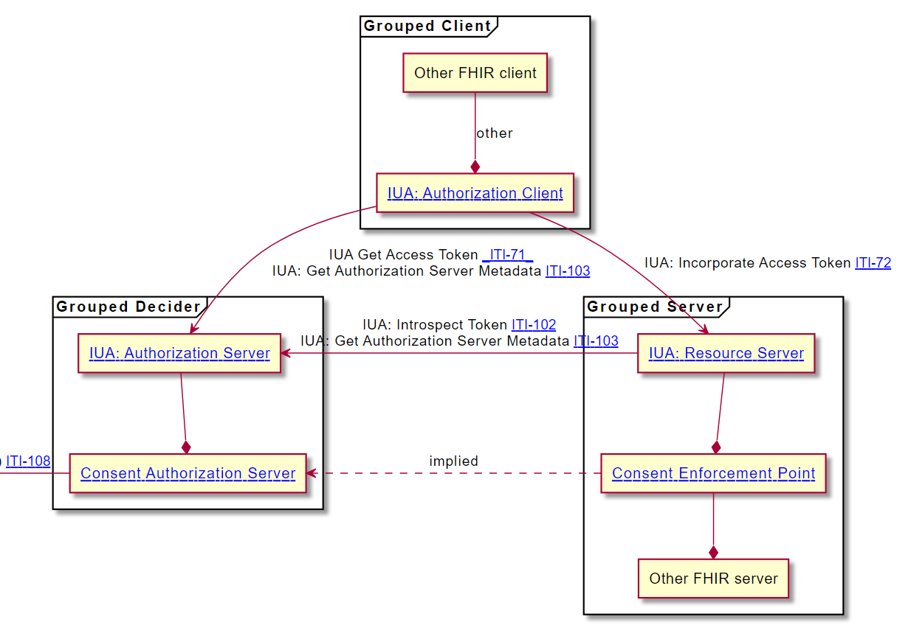
Access Control
Augments a typical oAuth flow
Where the typical oAuth flow is responsible for business rules such as RBAC
The Augmentation
adds to the oAuth Authorization Server that the Access Token only is issued if the Privacy Consents also agree that the Scope is to be authorized,
and any impact on the enforcement is inserted in the Access Token
so that the Consent Enforcement Point can further refine the interaction between the FHIR app and the Resource Server.

Slide 17
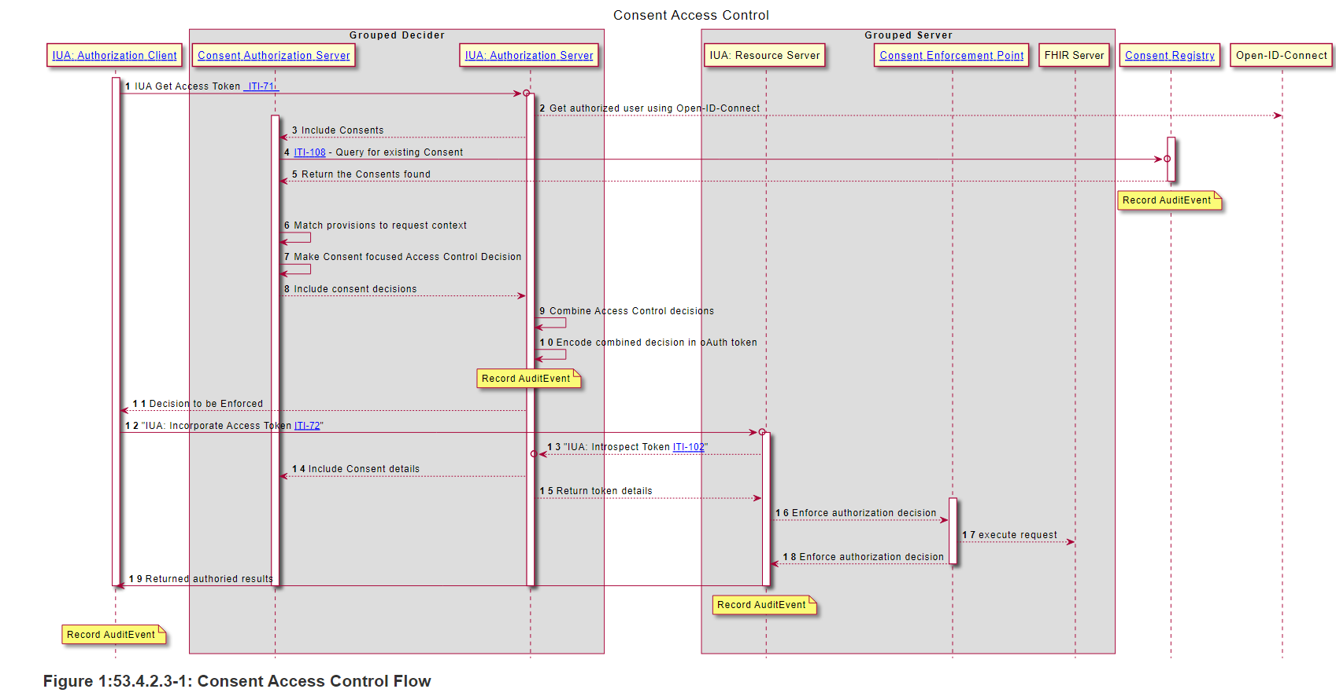
Access Control interaction diagram
Notes:
Diagram clipped from the IG. No intent to step thru this during the presentation.

Slide 18
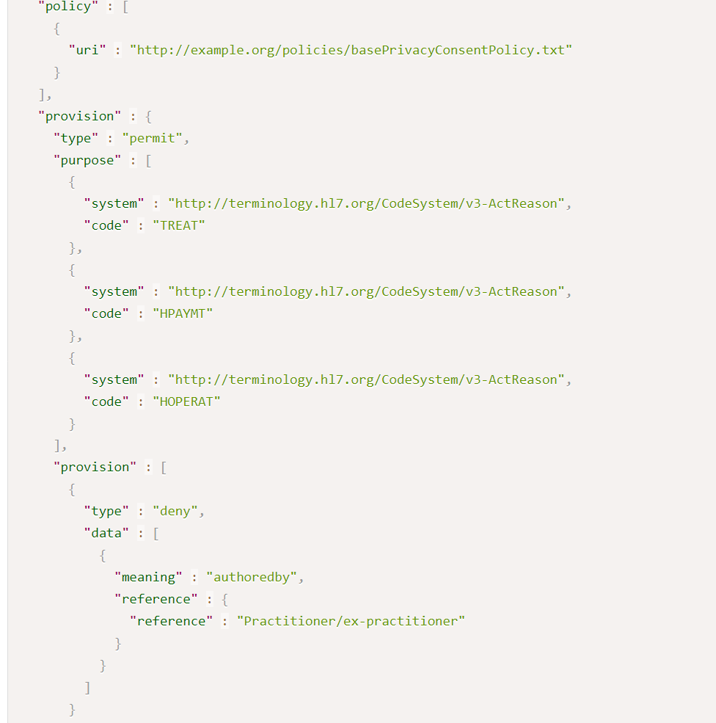
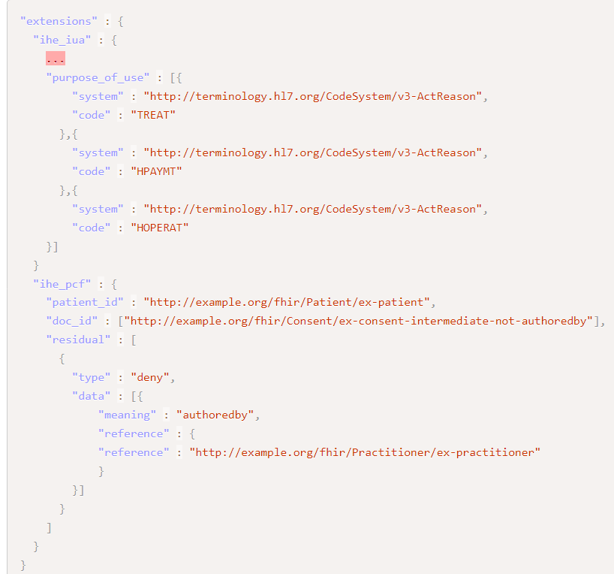
Example: Okay for TPO, but not data authored by Dr Bob
Consent excerpt
oAuth Access Token excerpt
→
Notes:
http://build.fhir.org/ig/IHE/ITI.PCF/branches/master/Consent-ex-consent-intermediate-not-authoredby.html

Slide 19
Hands On
https://profiles.ihe.net/ITI/PCF

Slide 20
Questions?
JohnMoehrke@gmail.com

